Slide 1

Innovation : Eyeglasses
Charles ENG
Kévin TANG
Loan BURGER

Slide 2
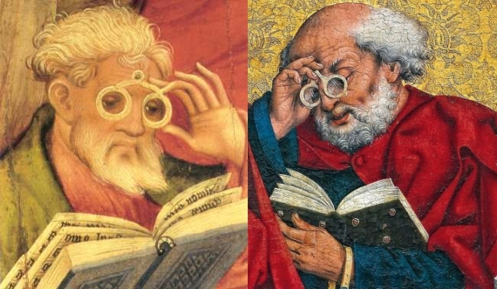
FIRST INVENTOR ?
Salvino D'Armate, 1284
Alessandro della Spina, 1260

Slide 3
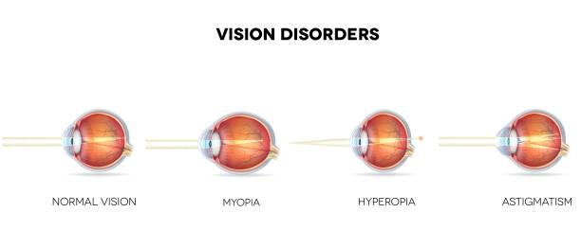
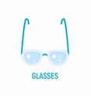
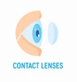

SOLUTIONS

Slide 4

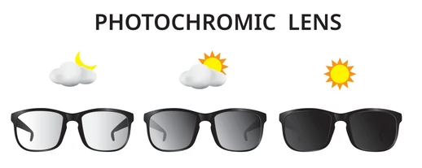


PREVENT EYE DAMAGE

Slide 5
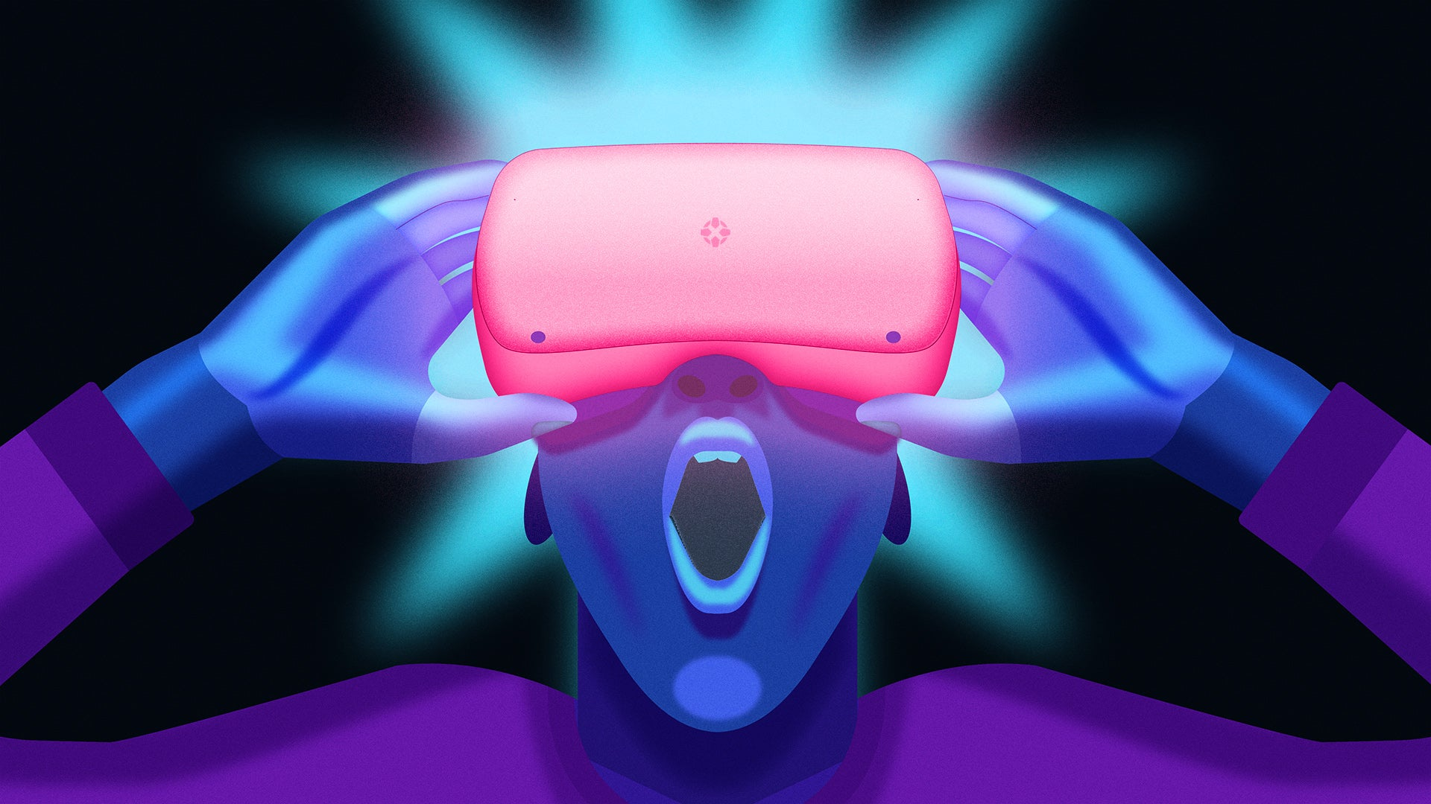

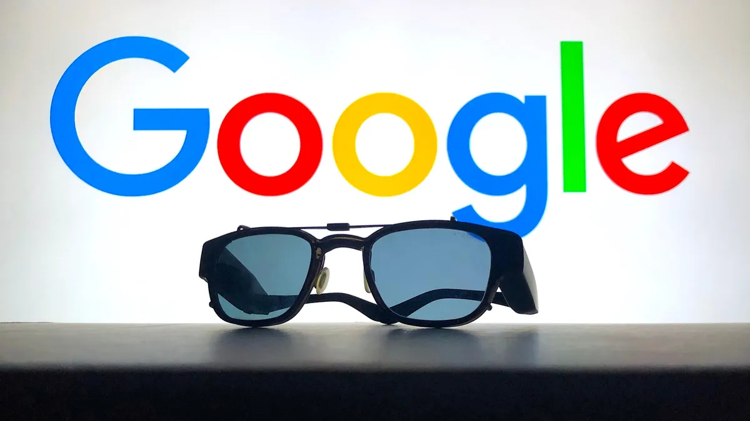
EVOLUTION & FUTURE APPLICATION
VR Headset
3D Glasses
Smart glasses by Google

Slide 6
Conclusion

